Slide 1
Energy Efficient Homes

Slide 2
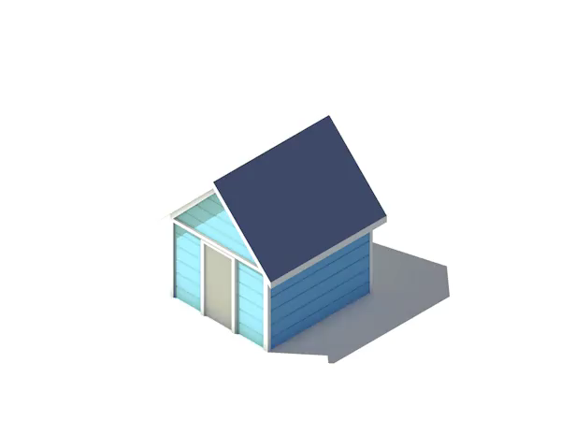
By the end of this lesson, you should be able to do the following:
Explain why it is important to build energy-efficient houses.
Describe how the orientation of a house affects its energy efficiency.
Understand how we arrange windows to reduce heat transfer.

Slide 3
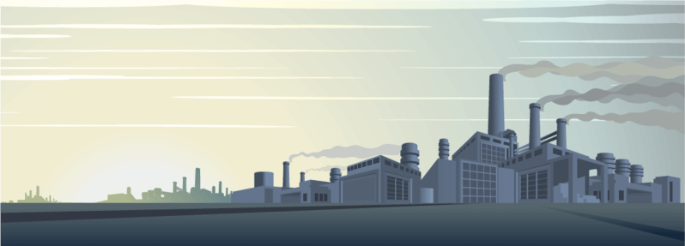
Most of Australia's power is created by power stations that are bad for the environment - they release carbon dioxide into the atmosphere.
Carbon dioxide is a greenhouse gas that contributes to heating the planet. Other poisonous gases are released by burning fuel, in smaller amounts.
If we use less energy, less pollution will be created by power stations. Therefore it is important to increase energy efficiency and decrease your personal energy use.

Slide 4
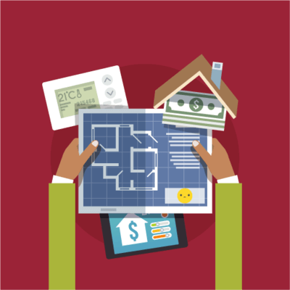
If your home is not energy efficient, you probably use more power than an energy-efficient home.
This means that you are going to be spending more money on power!
So while making a house energy-efficient seems like a big cost, it will likely save you money in the long run.

Slide 5
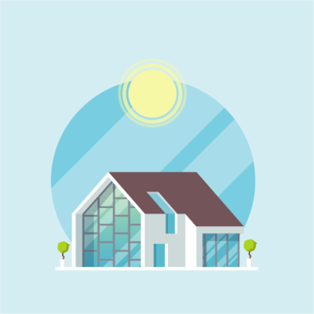
Approximately half of all the energy used by houses is used to keep it warm in winter and cool in summer.
We can reduce our energy use if we design houses to reduce the rate of heat transfer between the house and the environment.

Slide 6
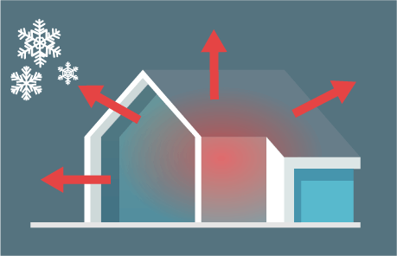
Heat always moves from warm areas to cold areas.
In winter, warm air from the heater can move through cracks and gaps in the walls to the cold environment.

Slide 7
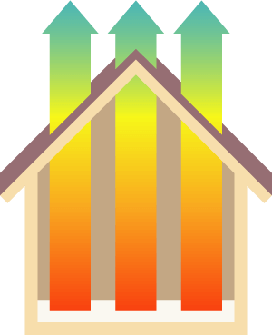
In winter, heat can also rise and pass through the roof of the house to the environment.
This means that it takes a lot of energy to keep houses warm in winter!

Slide 8
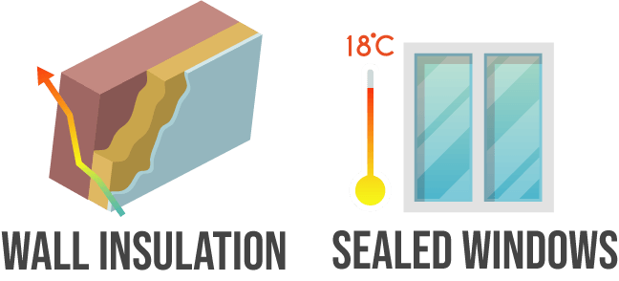
We can reduce the amount of energy needed to keep houses warm in winter.
We can do this by putting insulation into the walls and roofs. This slows down the rate of heat transfer.
We can also make sure that there are no gaps in the walls. For example, a tight seal around the edges of a window could prevent heat from escaping there.

Slide 9
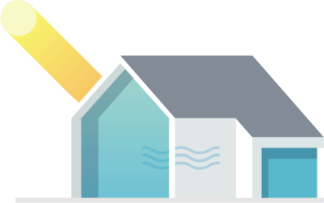
In summer, heat moves from the hot environment into the cool house.
We use air conditioners to keep our house cool when this happens. However, these use a lot of energy.
Insulation can also be used to keep houses cool in summer because it slows down the rate of heat transfer!

Slide 10
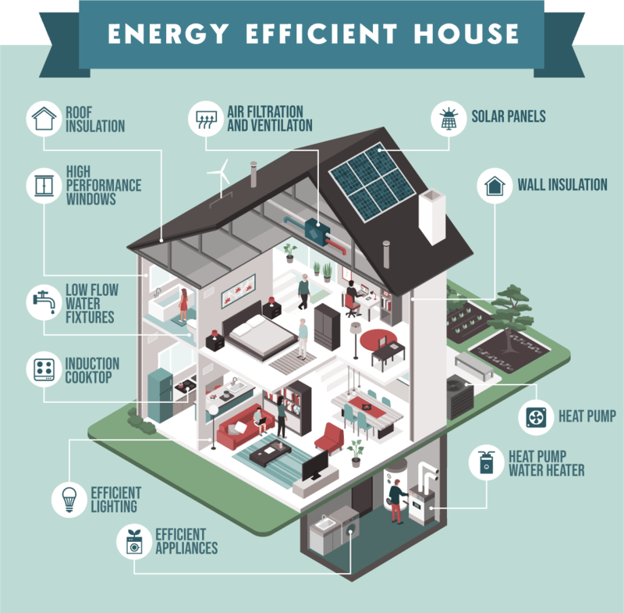
The design of a house can be used to reduce the amount of energy needed to control the temperature of the house.

Slide 11
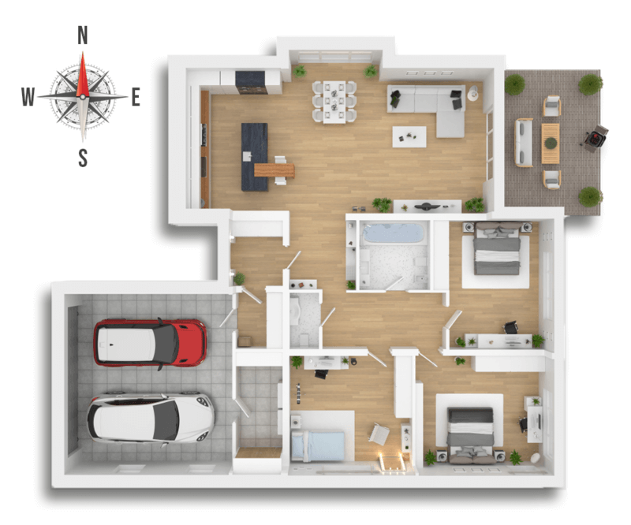
In the Southern Hemisphere, the west side of houses gets very hot while the south side remains cold.
This means that heat transfer will occur quickly through the west wall in summer and the south wall in winter.

Slide 12
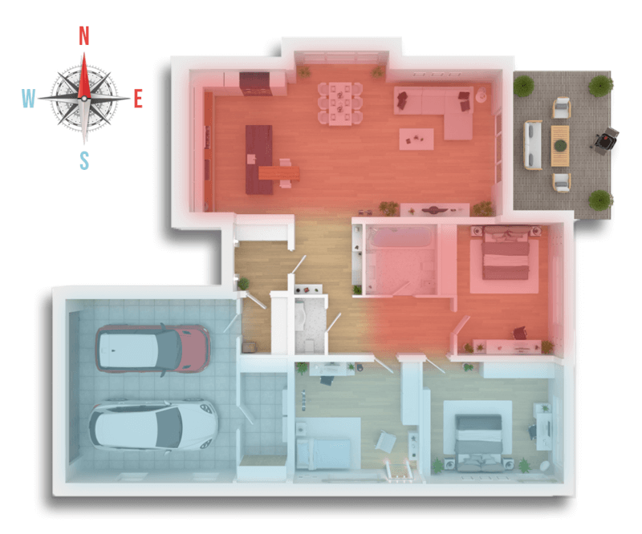
We orient houses so that the more important rooms have a slower rate of heat transfer.
Most houses have the living areas facing north and less important rooms, like the garage, facing south.
This is because its more important to have the living room at a comfortable temperature than areas like bathrooms and spare bedrooms.

Slide 13
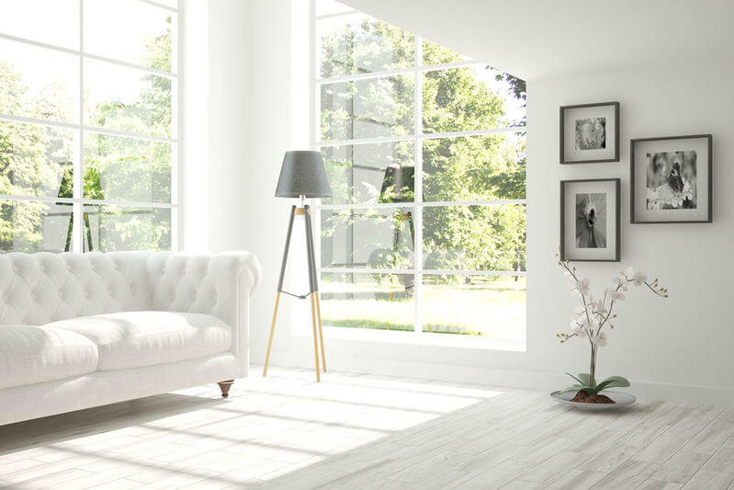
Most houses have large windows on the eastern and northern sides of the house.
We put small windows on the southern and western sides to reduce the rate of heat transfer.

Slide 14
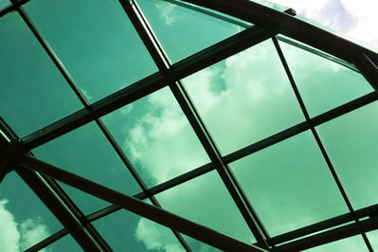
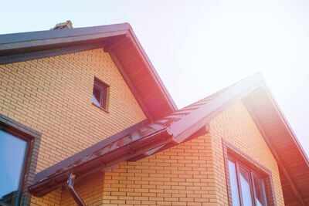
We tint or shade west facing windows to reduce heat transfer in summer.
Eaves and verandas are used to shade windows on the north and west sides of the house. This also reduces heat transfer in winter.

Slide 15
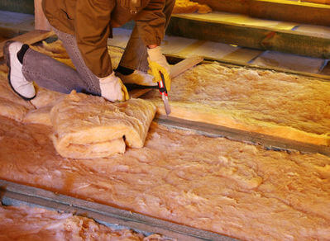
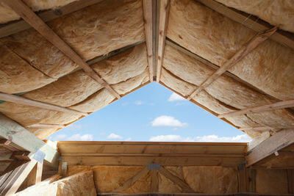
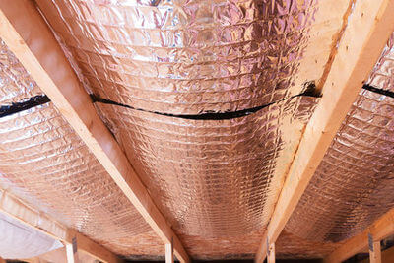
The floors, walls and roofs of modern, energy-efficient houses are all insulated.
This reduces energy loss.
Older houses often require extensive insulation and sealing of gaps to lift them to modern efficiency standards.

